Slide 1
Lecture 19

Slide 2
The Compound Microscope

Slide 3
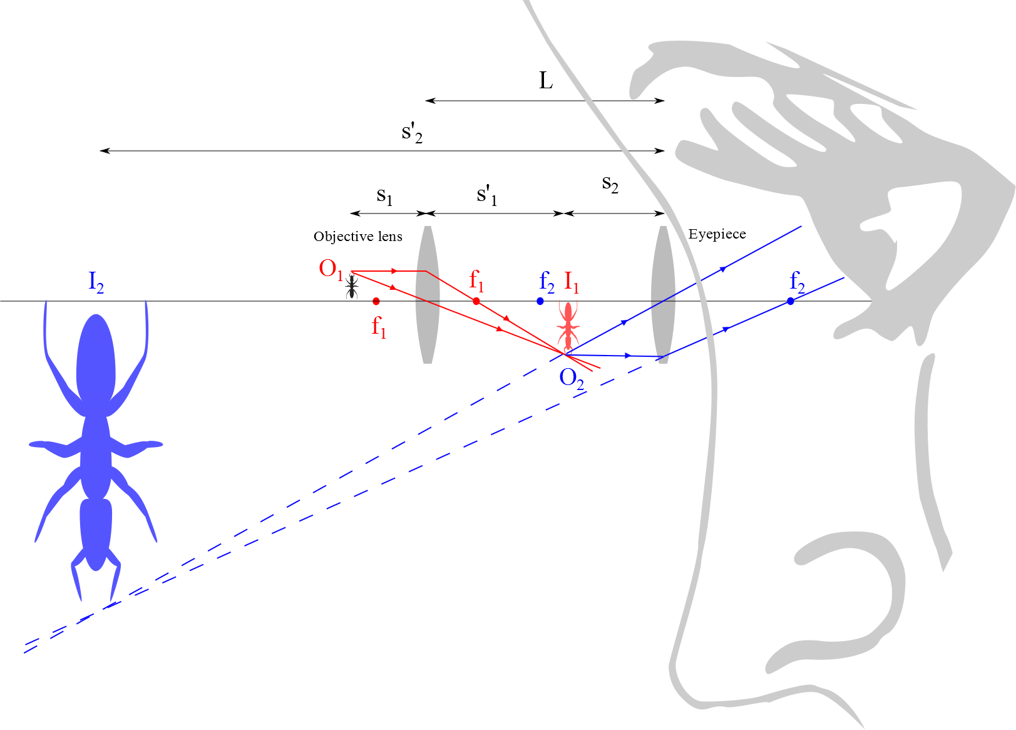
Compound Microscope

Slide 4
The telescope

Slide 5
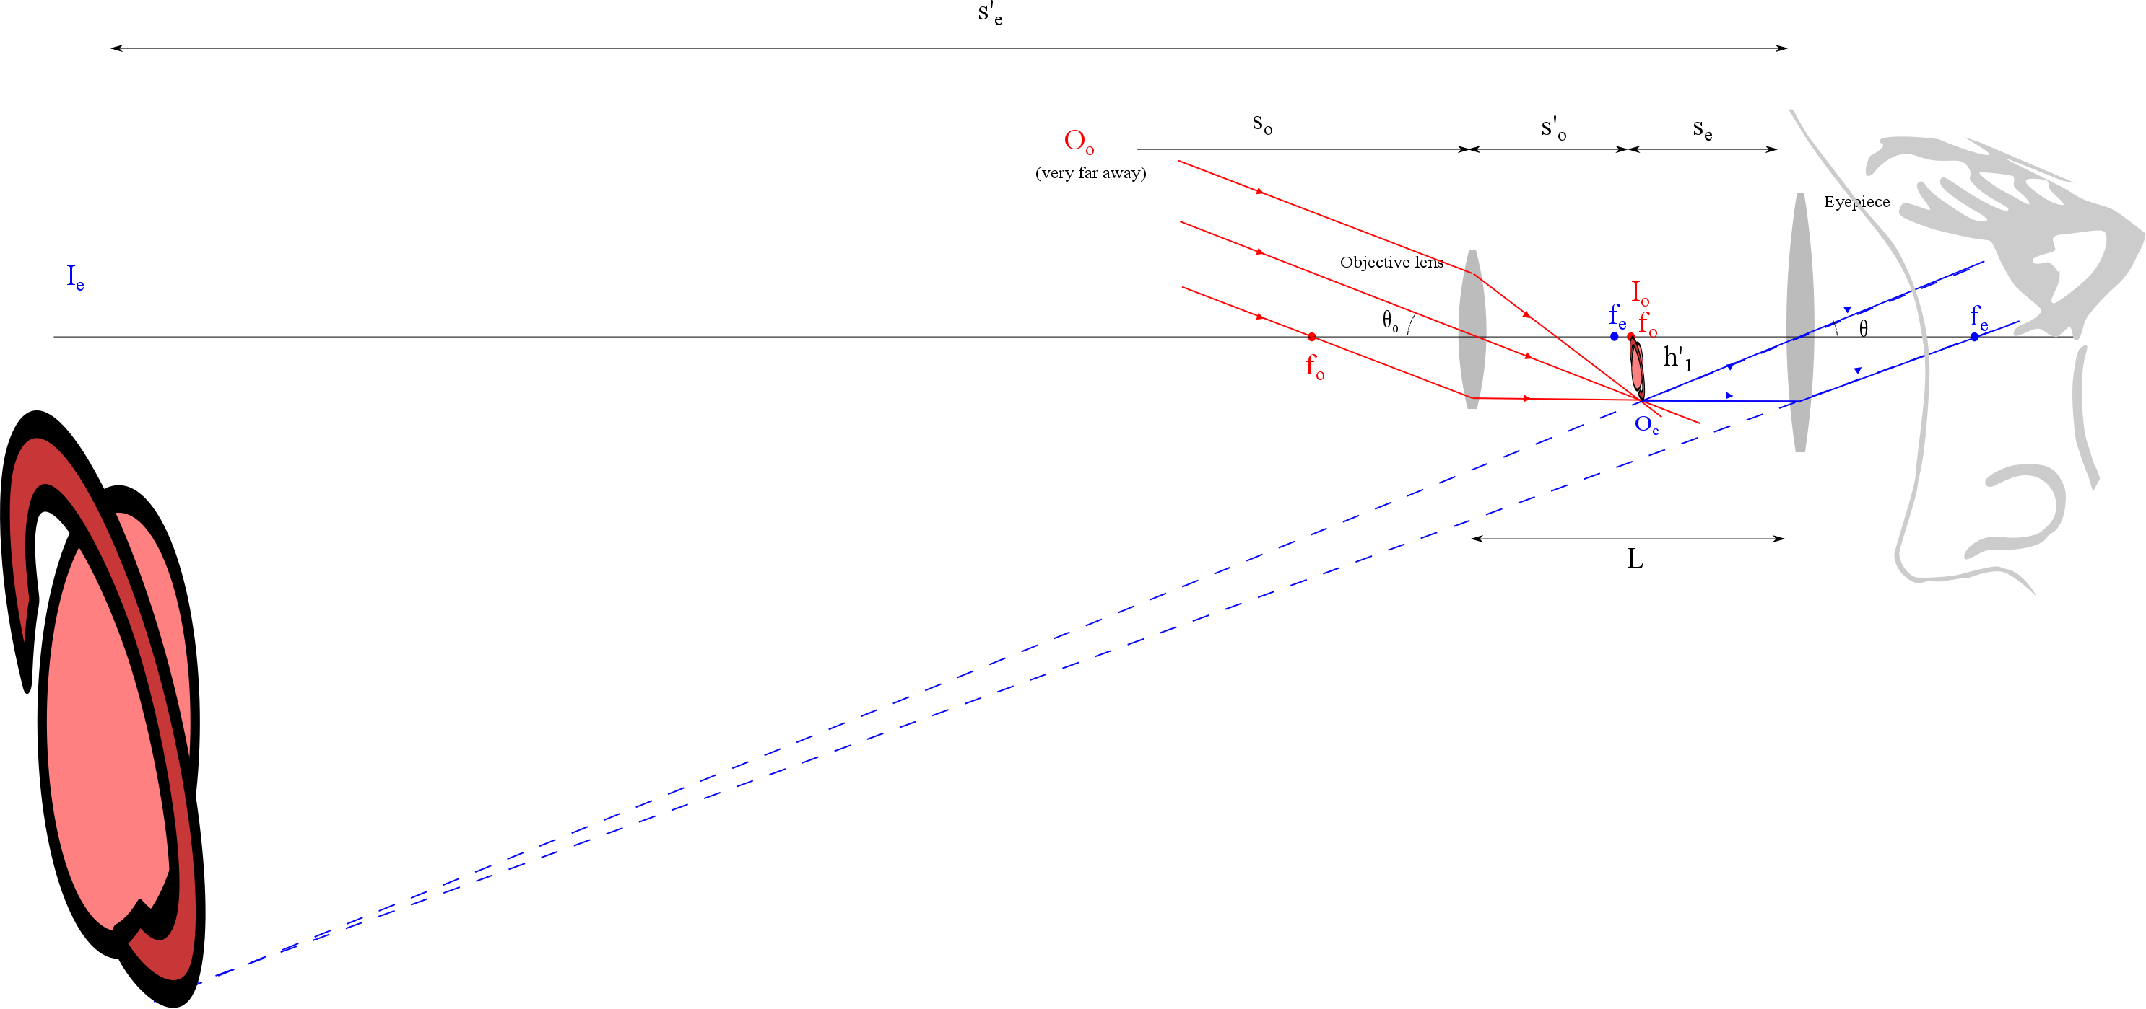

Slide 6
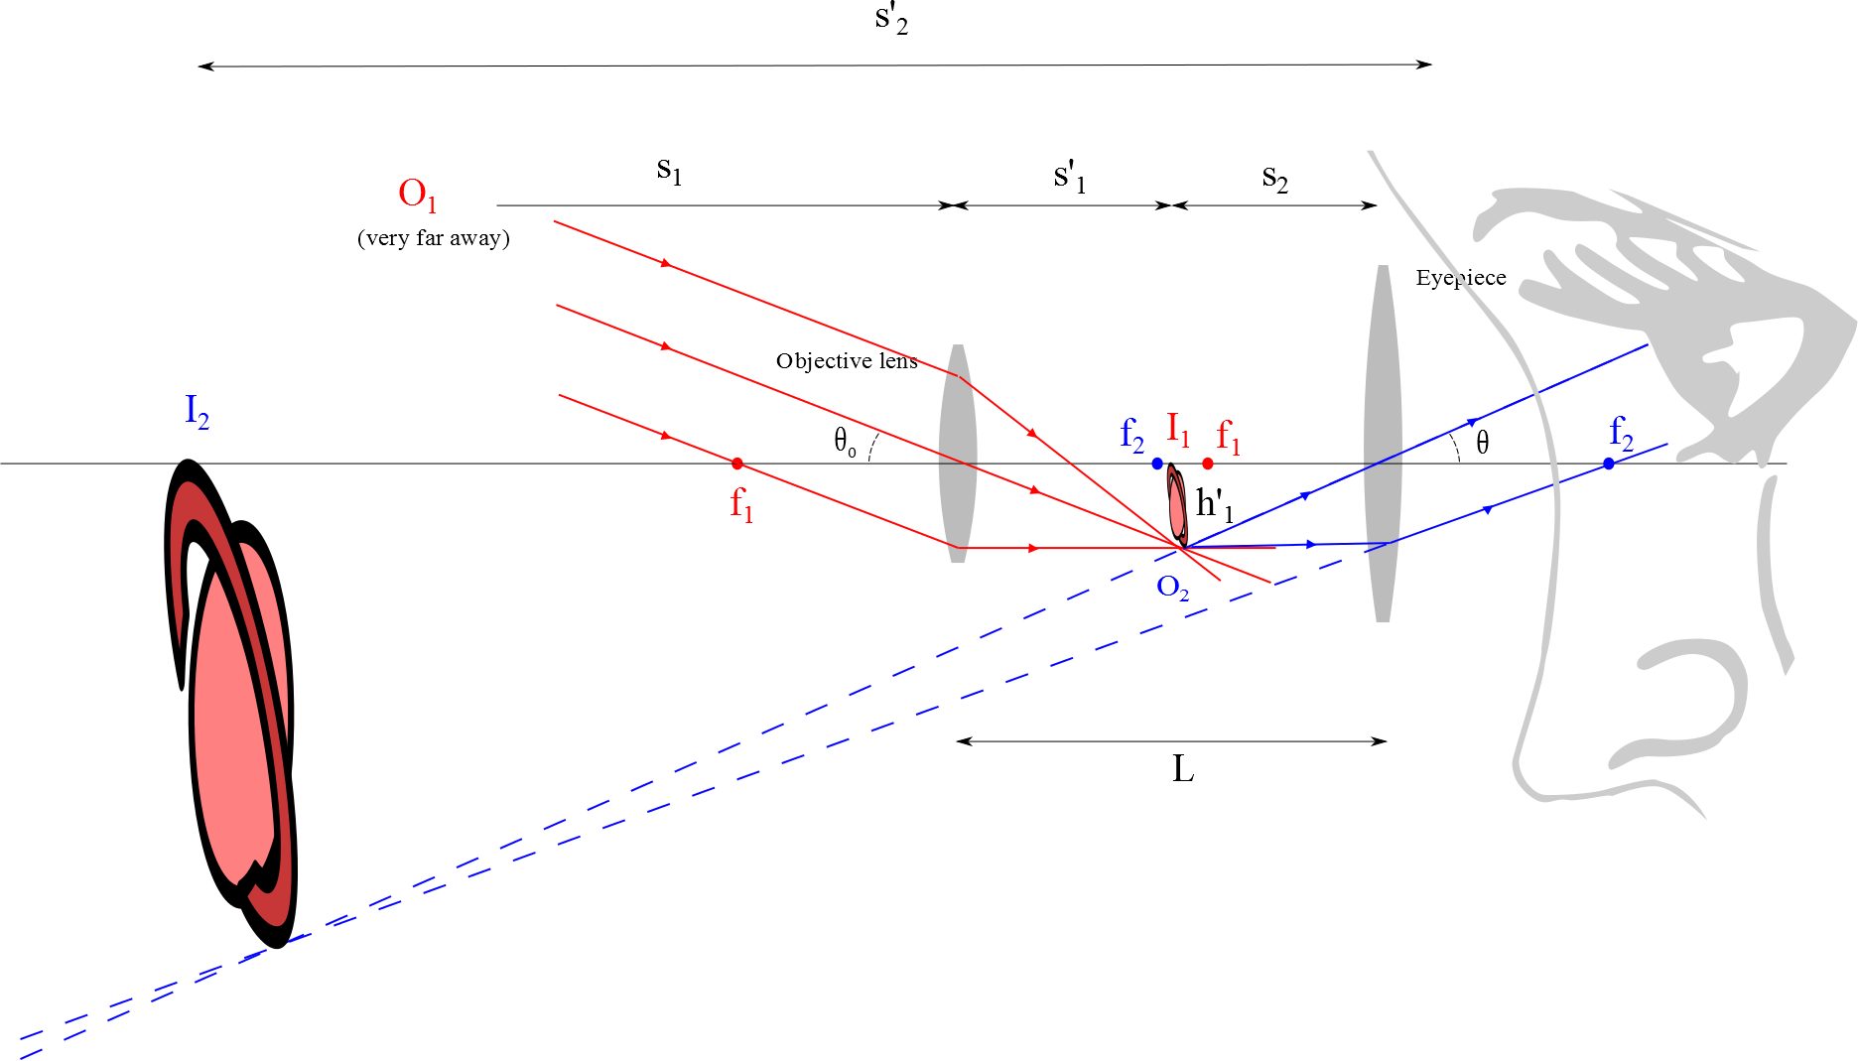
Refracting Telescope

Slide 7
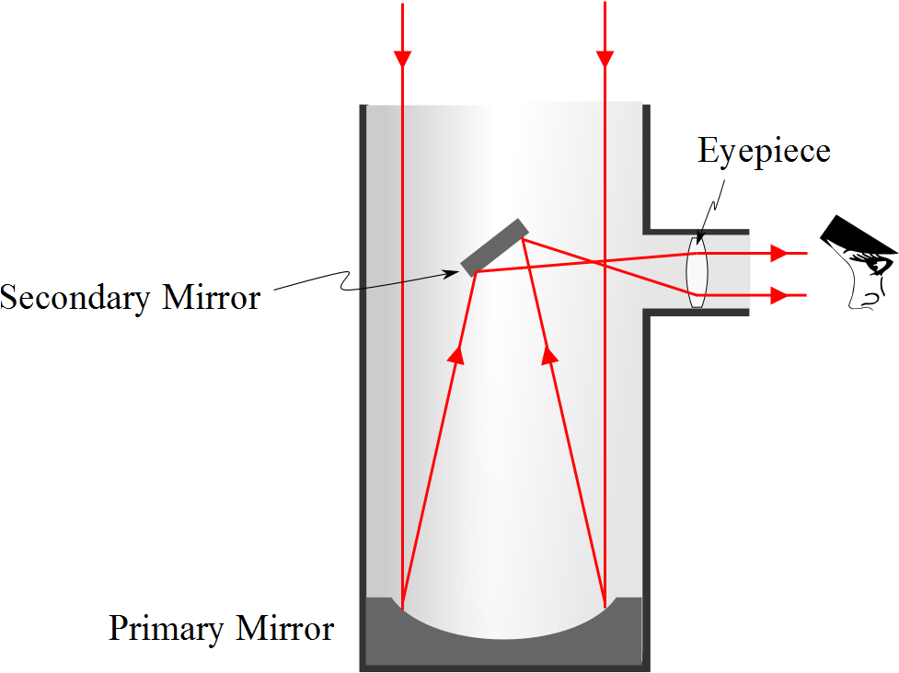
Reflecting Telescope: Newtonian

Slide 8
Examples of Telescopes
Reflecting Telescopes
Largest in the world are the 10-m diameter Keck telescopes on Mauna Kea in Hawaii
Each contains 36 hexagonally shaped, computer-controlled mirrors that work together to form a large reflecting surface
Refracting Telescopes
Largest in the world is Yerkes Observatory in Williams Bay, Wisconsin
Has a diameter of 1 m

Slide 9
Question 223.10.5
If you see a bright fringe in a “Young’s Experiment,” the path difference from the fringe to the slits must be equal to
And integer number of wavelengths
And integer number of half wavelengths
π
Arctan(θ)

Slide 10
Question 223.10.6
When considering order numbers, m, the possible orders are
1, 2, 3, . . .
0, 1, 2, 3, . . .
0, ±1, ± 2, ± 3, . . .
±1, ± 2, ± 3, . . .

Slide 11
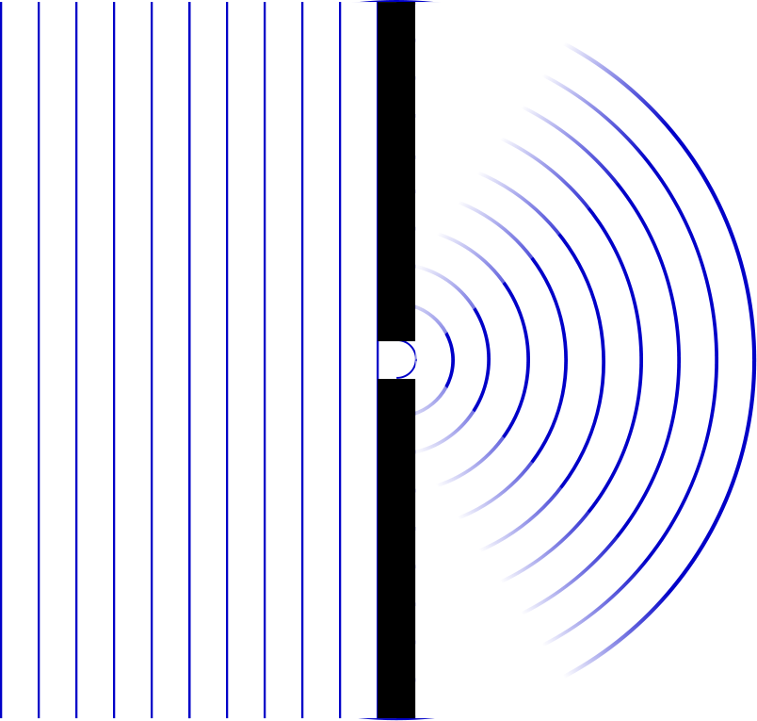

Slide 12
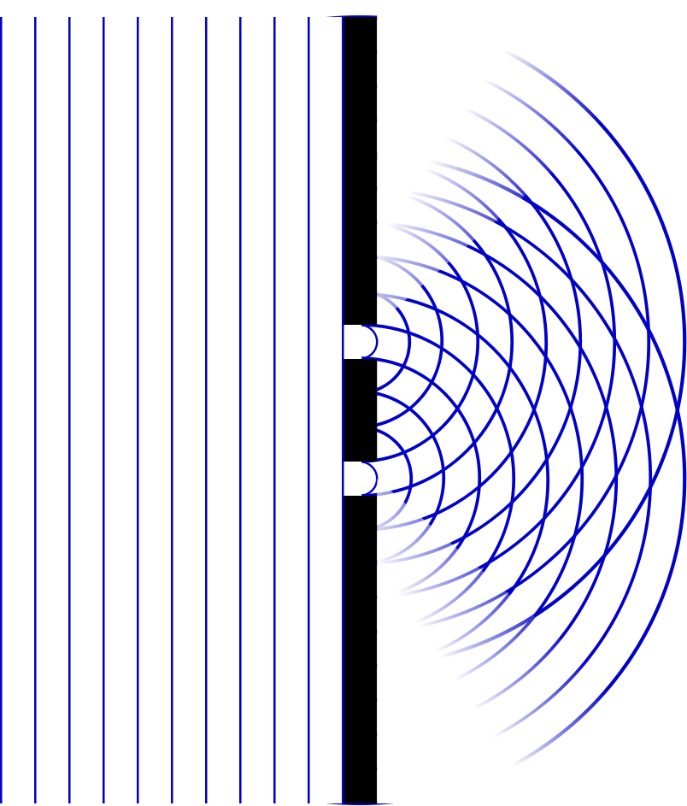

Slide 13
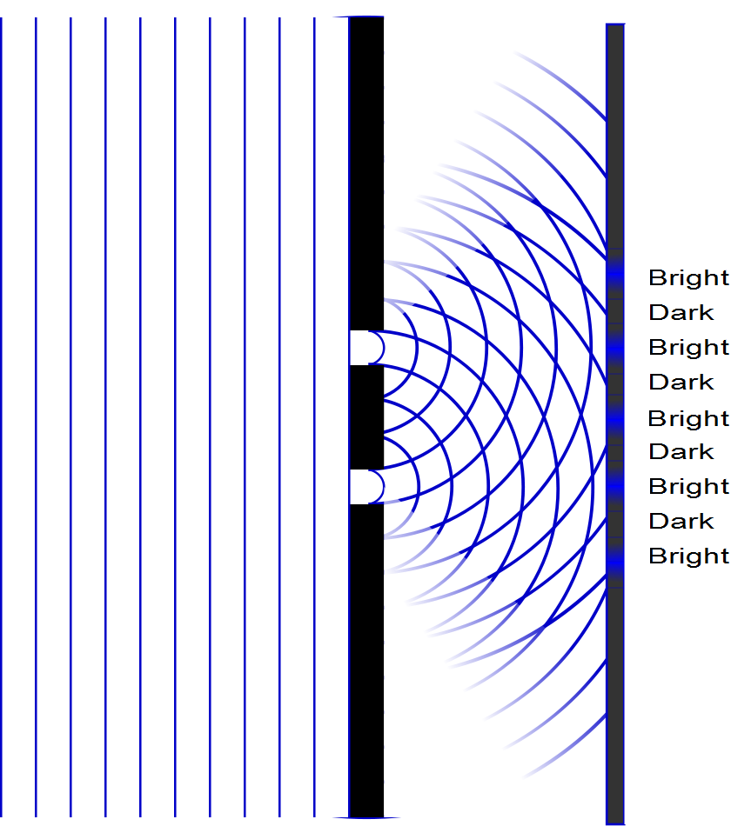

Slide 14
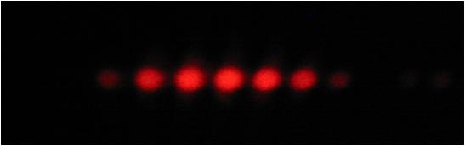

Slide 17
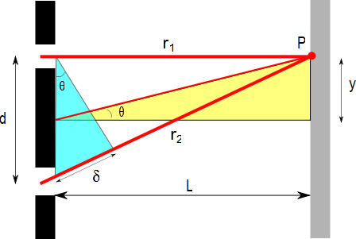
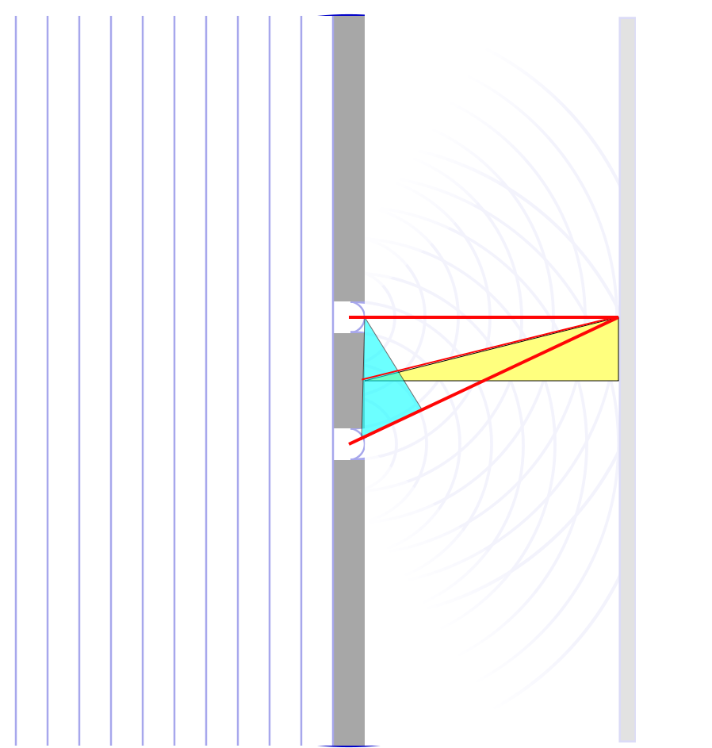

Slide 18
ConcepTest 24.3a Double Slits I
In a double-slit experiment, when the wavelength of the light is increased, the interference pattern
spreads out
stays the same
shrinks together
disappears

Slide 19
ConcepTest 24.3a Double Slits I
In a double-slit experiment, when the wavelength of the light is increased, the interference pattern
spreads out
stays the same
shrinks together
disappears
d sin θ = m λ
If λ is increased and d does not change, then θ must increase, so the pattern spreads out.

Slide 20
ConcepTest 24.3b Double Slits II
If instead the slits are moved farther apart (without changing the wavelength) the interference pattern
spreads out
stays the same
shrinks together
disappears

Slide 21
ConcepTest 24.3b Double Slits II
If instead the slits are moved farther apart (without changing the wavelength) the interference pattern
spreads out
stays the same
shrinks together
disappears
d sin θ = m λ
If instead d is increased and λ does not change, then θ must decrease, so the pattern shrinks together
Follow-up: When would the interference pattern disappear?

Slide 22
ConcepTest 24.4 Path Difference
In a double-slit experiment, what path difference have the waves from each slit traveled to give a minimum at the indicated position?
there is no difference
half a wavelength
one wavelength
three wavelengths
more than three wavelengths
Intensity

Slide 23
ConcepTest 24.4 Path Difference
In a double-slit experiment, what path difference have the waves from each slit traveled to give a minimum at the indicated position?
there is no difference
half a wavelength
one wavelength
three wavelengths
more than three wavelengths
λ
For Destructive Interference
δ = 1/2 λ, 3/2 λ, 5/2 λ, 7/2 λ, …
= (m + 1/2) λ
2λ
3λ
Intensity
λ/2
3λ/2
5λ/2
7λ/2

Slide 24
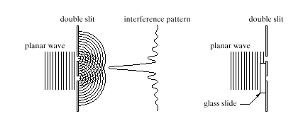
ConcepTest 24.5 Interference Pattern
pattern vanishes
pattern expands
bright and dark spots are interchanged
pattern shrinks
no change at all
An interference pattern is seen from two slits. Now cover one slit with glass, introducing a phase difference of 180° (1/2 wavelength) at the slits. How is the pattern altered?
Double slit Interference pattern
wave

Slide 25
ConcepTest 24.5 Interference Pattern
An interference pattern is seen from two slits. Now cover one slit with glass, introducing a phase difference of 180° (1/2 wavelength) at the slits. How is the pattern altered?
pattern vanishes
pattern expands
bright and dark spots are interchanged
pattern shrinks
no change at all
If the waves originating from the two slits have a phase difference of 180° when they start off, the central spot will now be dark !! To the left and the right, there will be bright spots. Thus, bright and dark spots are interchanged.
Double slit Interference pattern
wave
Follow-up: What happens when the phase difference is 90°?

Slide 28
I
Interference fringes:
due to having two slits.
φ/2
-5π
-3π
-π
π
3π
5π

Slide 29
End

Slide 30
Question 223.18.4
What is the power (in Diopters) of a lens with a focal distance of 0.5m?
5
4
3
2
1

Slide 31
Simple Magnifier
A simple magnifier consists of a single converging lens
This device is used to increase the apparent size of an object
The size of an image formed on the retina depends on the angle subtended by the eye

Slide 32
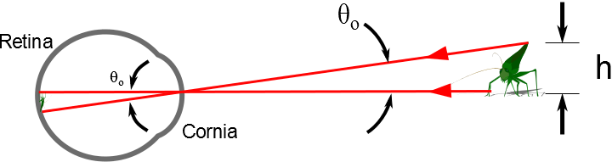

Slide 33
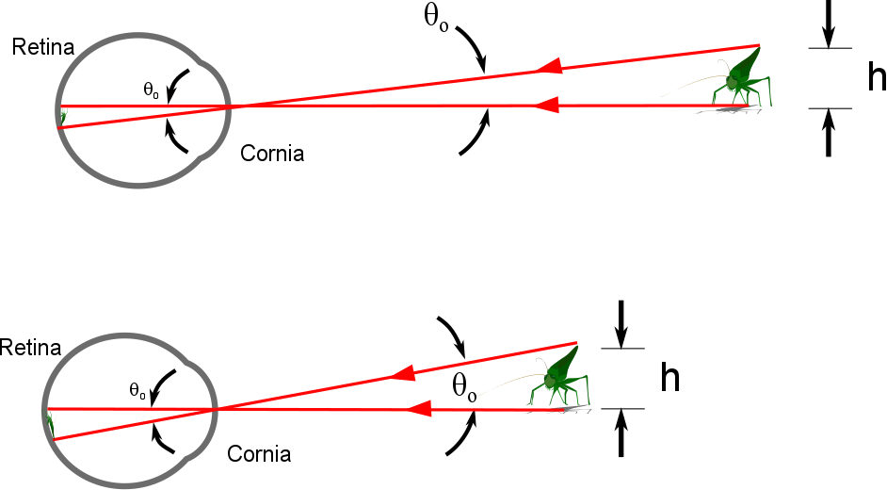

Slide 34
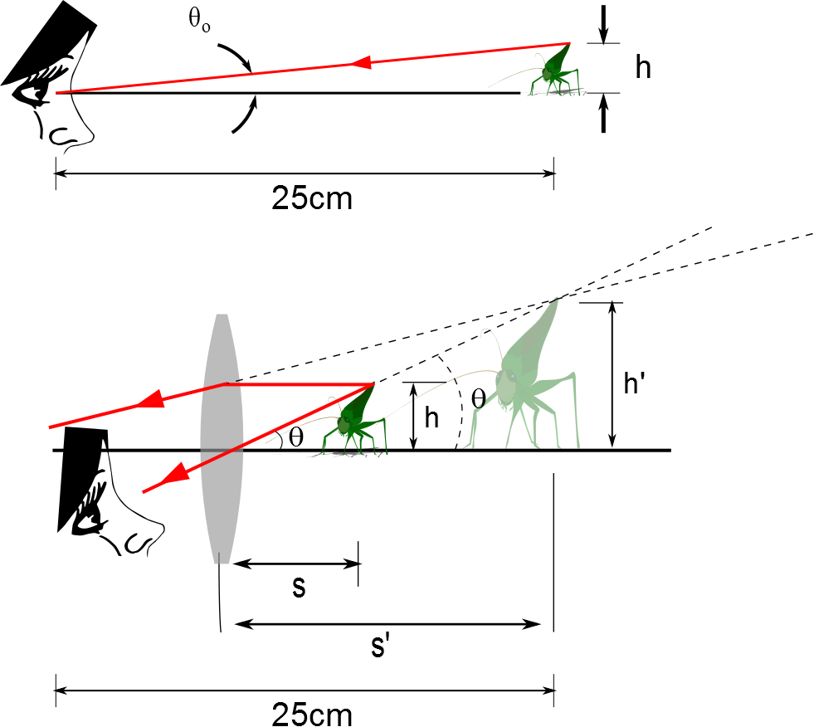
The Size of a Magnified Image
When an object is placed at the near point, the angle subtended is a maximum
The near point is about 25 cm
When the object is placed near the focal point of a converging lens, the lens forms a virtual, upright, and enlarged image

Slide 35
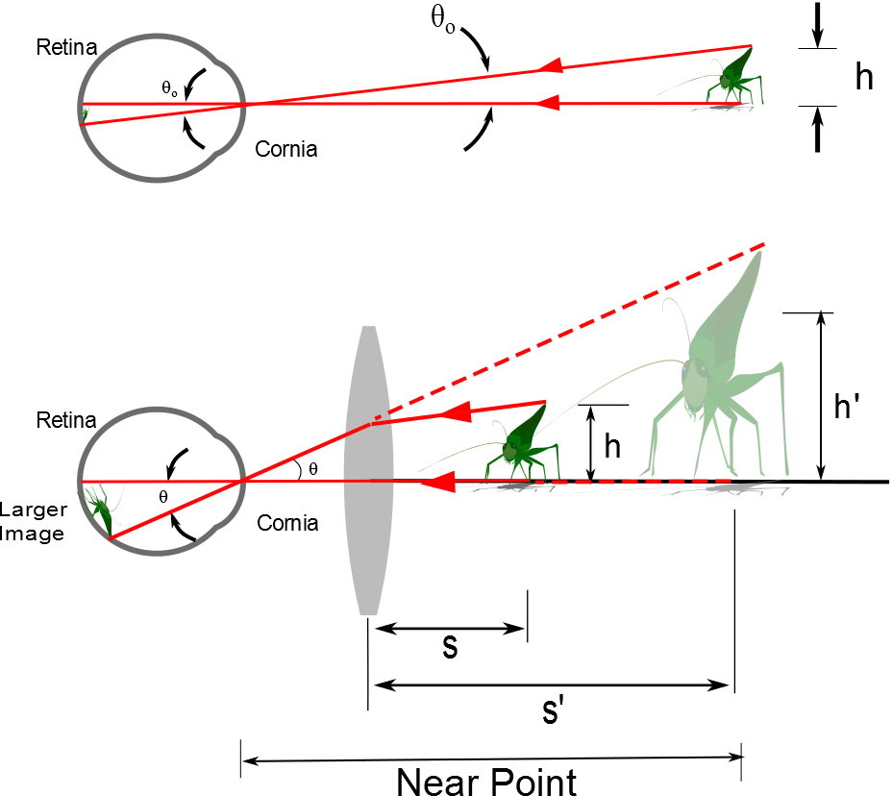
d

Slide 36
Angular Magnification
Angular magnification is defined as
The angular magnification is at a maximum when the image formed by the lens is at the near point of the eye
s’ = - 25 cm
Calculated by

Slide 37
Angular Magnification, cont.
The eye is most relaxed when the image is at infinity
Although the eye can focus on an object anywhere between the near point and infinity
For the image formed by a magnifying glass to appear at infinity, the object has to be at the focal point of the lens
The angular magnification is

Slide 38
Magnification by a Lens
With a single lens, it is possible to achieve angular magnification up to about 4 without serious aberrations
With multiple lenses, magnifications of up to about 20 can be achieved
The multiple lenses can correct for aberrations

Slide 39
The Compound Microscope

Slide 40
Compound Microscope

Slide 41
The telescope

Slide 43
Refracting Telescope

Slide 44
Reflecting Telescope: Newtonian

Slide 45
Examples of Telescopes
Reflecting Telescopes
Largest in the world are the 10-m diameter Keck telescopes on Mauna Kea in Hawaii
Each contains 36 hexagonally shaped, computer-controlled mirrors that work together to form a large reflecting surface
Refracting Telescopes
Largest in the world is Yerkes Observatory in Williams Bay, Wisconsin
Has a diameter of 1 m

Slide 46
Resolution

Slide 47
Question 223.19.1
Resolution is
The ending argument in a debate
The ability to distinguish separate point sources in an optical image
The distance between bright fringes in a diffraction pattern
The distance between dark fringes in a diffraction pattern

Slide 48
Question 233.19.2
Cat’s eyes have pupils that can be modeled as vertical slits. At night, would cats be more successful in resolving
Headlights on a distant car
Vertically separated lights on the mast of a distant boat?

Slide 49
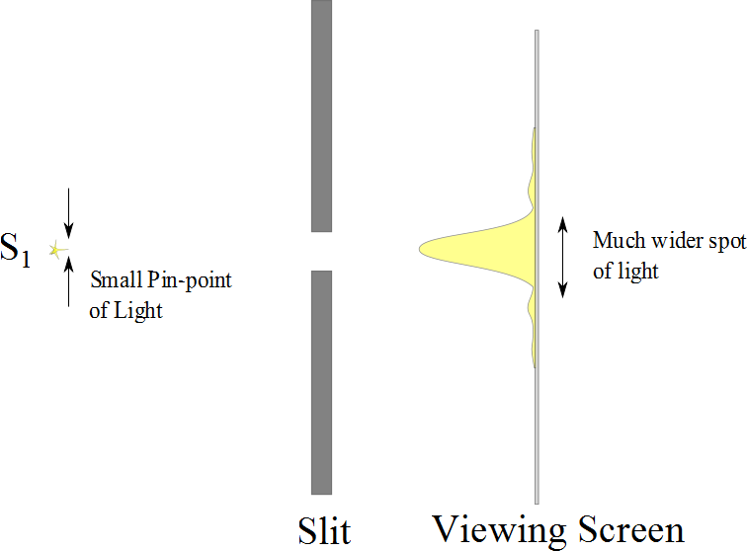

Slide 50
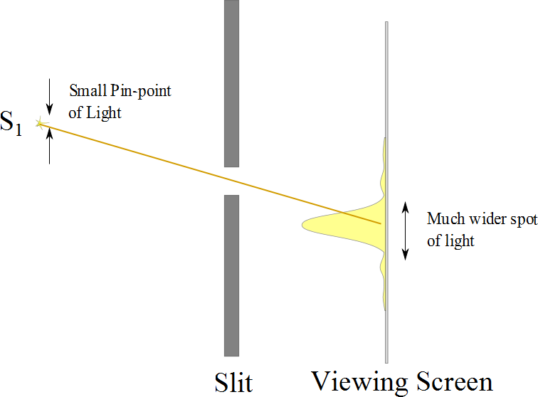

Slide 51
Resolution

Slide 52
Resolution
The ability of optical systems to distinguish between closely spaced objects is limited because of the wave nature of light
If two sources are far enough apart to keep their central maxima from overlapping, their images can be distinguished
The images are said to be resolved
If the two sources are close together, the two central maxima overlap and the images are not resolved

Slide 53


Slide 54
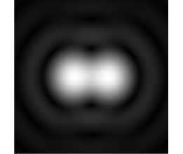

Slide 55
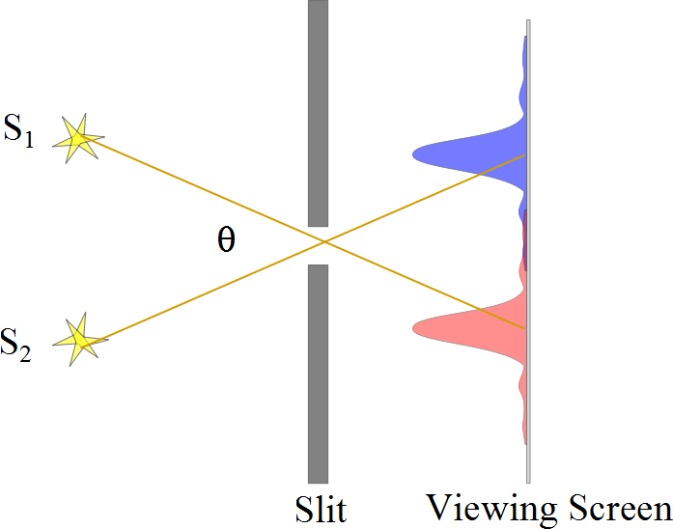
Resolved Images, Example

Slide 56
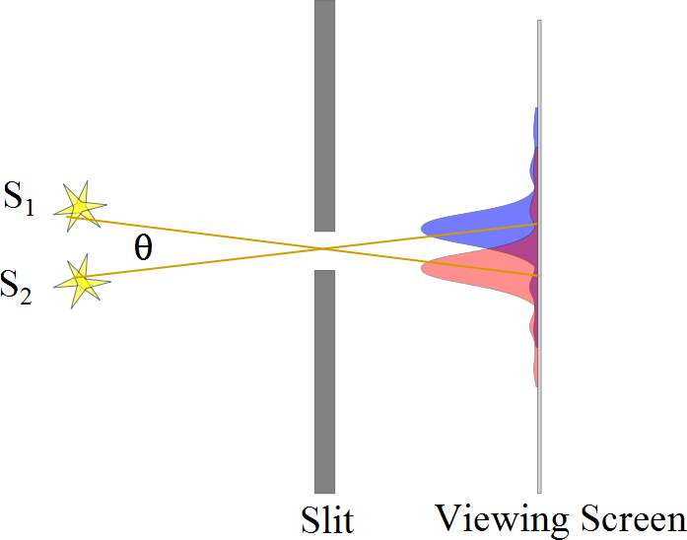
Barely Resolved, Example

Slide 57
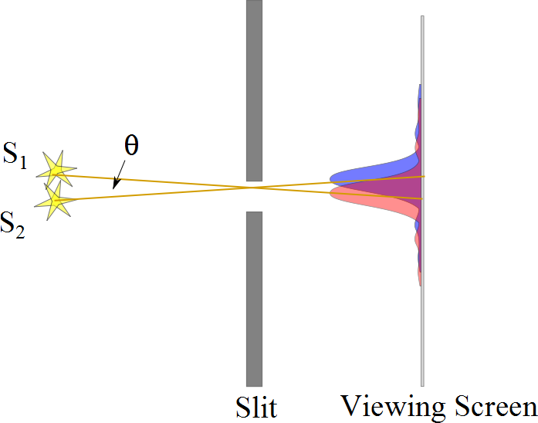
Images Not Resolved, Example

Slide 58
Resolution
The ability of optical systems to distinguish between closely spaced objects is limited because of the wave nature of light
If two sources are far enough apart to keep their central maxima from overlapping, their images can be distinguished
The images are said to be resolved
If the two sources are close together, the two central maxima overlap and the images are not resolved

Slide 60
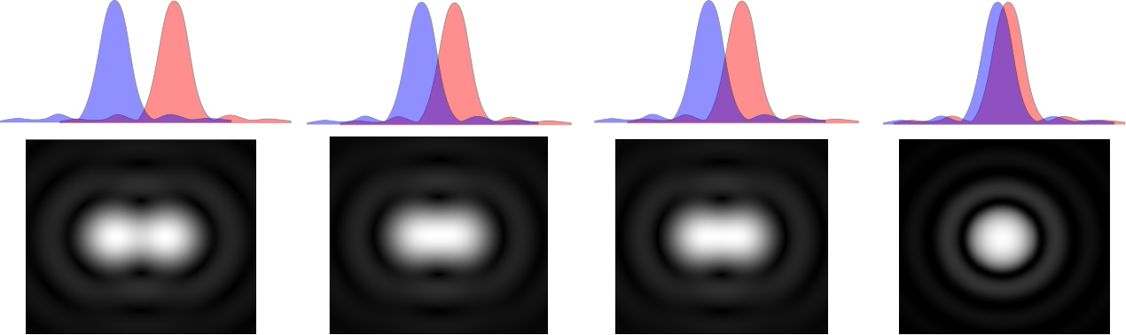

Slide 62
Resolution, Rayleigh’s Criterion
When the central maximum of one image falls on the first minimum of another image, the images are said to be just resolved
This limiting condition of resolution is called Rayleigh’s criterion

Slide 63
Resolution, Rayleigh’s Criterion, Equation
The angle of separation, θ_{min}, is the angle subtended by the sources for which the images are just resolved
Since λ << a in most situations, sin θ is very small and sin θ ≈ θ
Therefore, the limiting angle (in rad) of resolution for a slit of width a is
To be resolved, the angle subtended by the two sources must be greater than θ_{min}

Slide 64
Circular Apertures
The diffraction pattern of a circular aperture consists of a central bright disk surrounded by progressively fainter bright and dark rings
The limiting angle of resolution of the circular aperture is
D is the diameter of the aperture

Slide 65
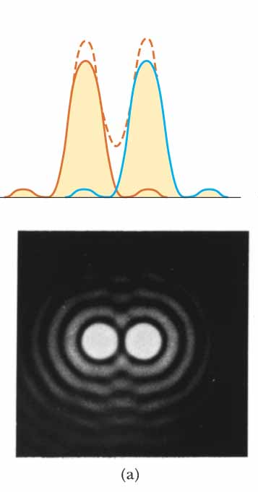
Circular Apertures, Well Resolved
The sources are far apart
The images are well resolved
The solid curves are the individual diffraction patterns
The dashed lines are the resultant pattern

Slide 66
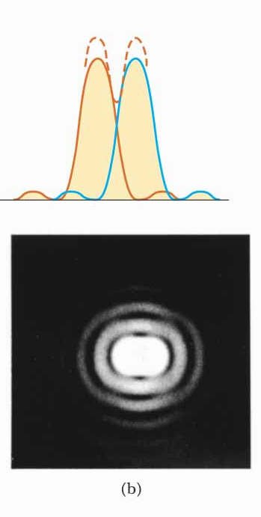
Circular Apertures, Just Resolved
The sources are separated by an angle that satisfies Rayleigh’s criterion
The images are just resolved
The solid curves are the individual diffraction patterns
The dashed lines are the resultant pattern

Slide 67
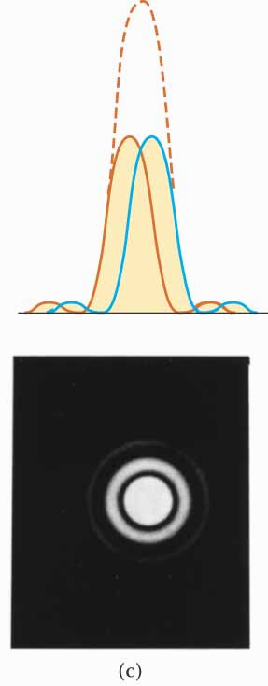
Circular Apertures, Not Resolved
The sources are close together
The images are unresolved
The solid curves are the individual diffraction patterns
The dashed lines are the resultant pattern

Slide 68
Completely Resolved
Rayleigh Criterion
Sparrow Criterion
Unresolved

Slide 69
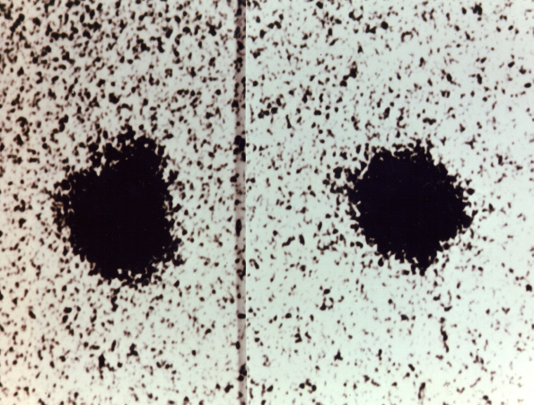
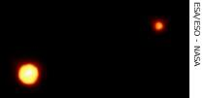
Resolution, Example
Charon
Pluto
Pluto and its moon, Charon
Left: Earth-based telescope is blurred
Right: Hubble Space Telescope clearly resolves the two objects

